Slide 1
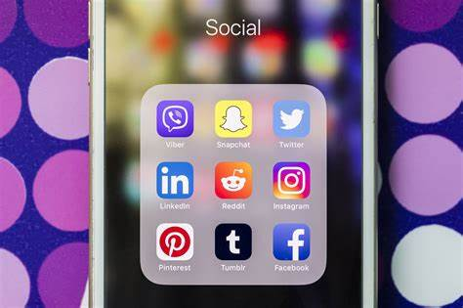
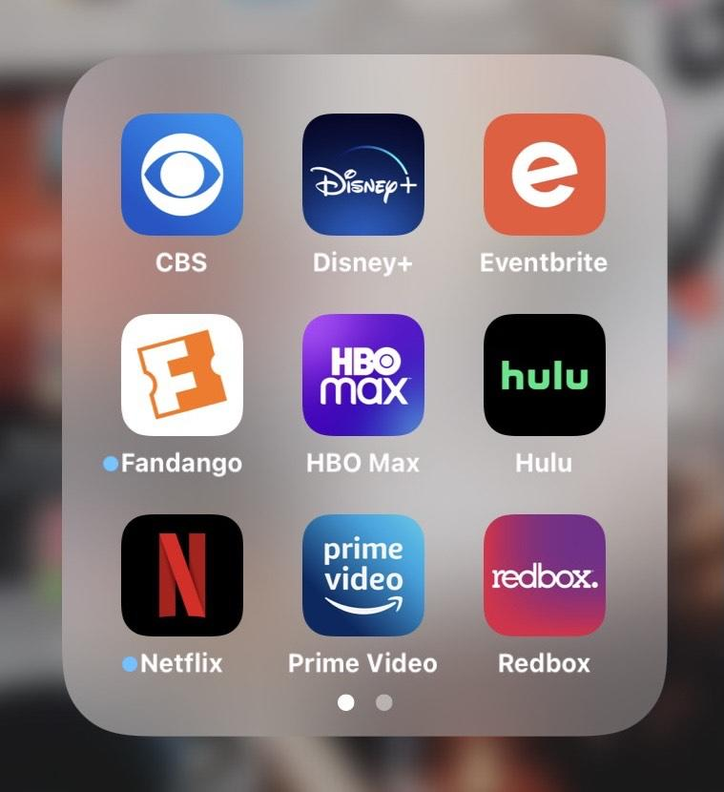
Investigating the
Change in
Smartphone Usage
and Mental Health
For STA304H5 Fall 2022 Students From Before To During COVID-19

Slide 2





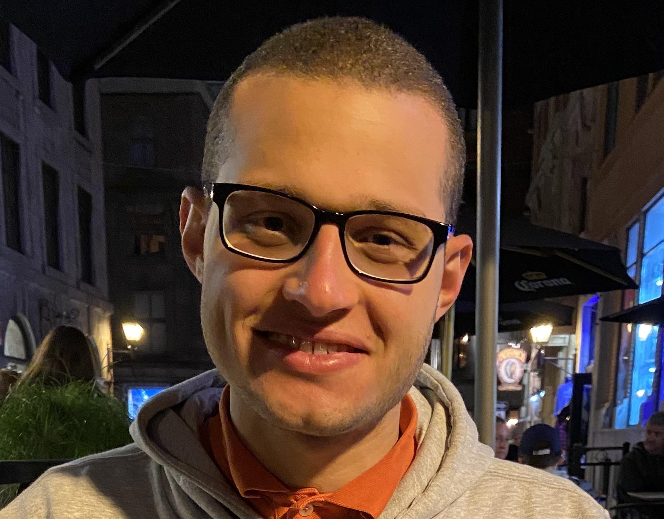

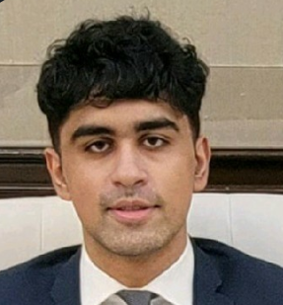
MEET OUR TEAM: DataMountaineers
Purumidha Sharma
Ruthba Tahiya
Abdur Imtiyas
Saad Afridi
Osama Saleh
Marvin Roopchan
Mautasim Siddiqui

Slide 3
INTRODUCTION
01
To Our Study
Notes:
Mautasim

Slide 4
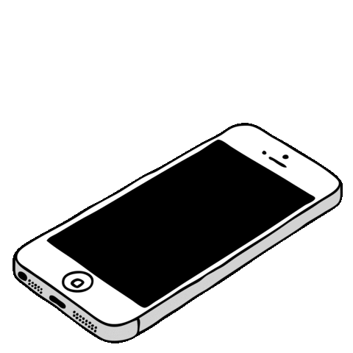
Overview
Why this study is important
High Level Study Variables
Hypothesis : Smartphone Usage & Mental Health Score During Covid
Notes:
Osama & Mautasim

Slide 5
Results
02
Includes Computations, Results, Graphs

Slide 6

Computations and Visualizations
Sample size is 66 students
Leveraged Simple Random Sampling (without replacement)
Computed statistics
For example, average smartphone usage before and during Covid

Slide 7
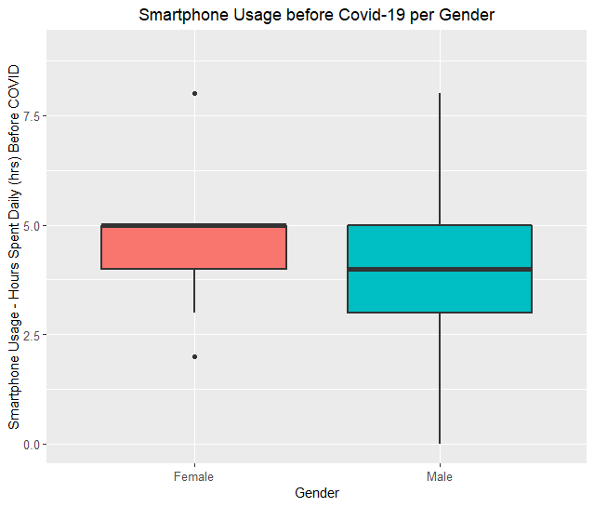
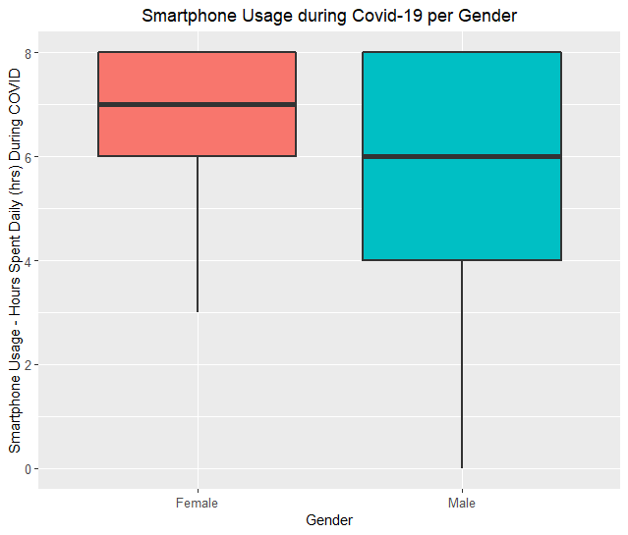
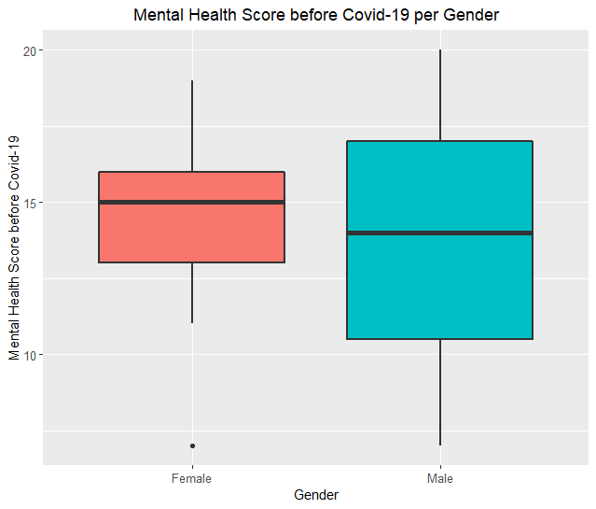
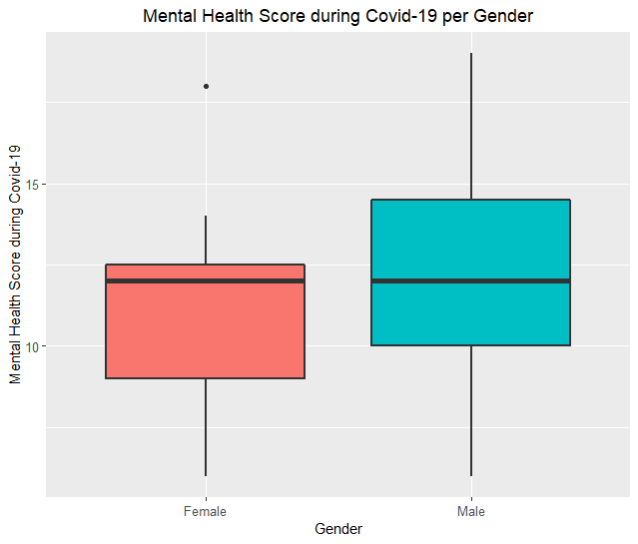

Slide 8

Hypothesis Testing and Cronbach’s Alpha
Hypothesis Testing:
Paired-Sign Test
Rejecting our claims
Cronbach Alpha:
Measured on a scale of 0.0-1.0
Inconsistent questionnaire

Slide 9
CONCLUSION
03
Includes Limitations in our Study

Slide 10


TO WRAP UP
Findings
LIMITATIONS
Average STA304H5 students’ smartphone usage differed from before Covid-19 to during Covid-19
Average STA304H5 students’ mental health score differed from before Covid-19 to during Covid-19
Convenience Sampling
Unreliability and Inconsistency with the questionnaire
Lack of incentive to fill the questionnaire
Length of the questionnaire

Slide 11


